Slide 1

Stack Overflow Developer Survey: Technology Trends & Insights
Hanieh Asghari Oskoei
May 3, 2026

Slide 2



OUTLINE
Executive Summary
Introduction
Methodology
Results
Visualization – Charts
Dashboard
Discussion
Findings & Implications
Conclusion
Appendix

Slide 3

EXECUTIVE SUMMARY
This report analyzes the Stack Overflow Developer Survey to uncover global technology trends across programming languages, databases, platforms, web frameworks, and developer demographics.
Key Findings:
JavaScript is the most widely used language (14,943 respondents) and remains the most desired for the year ahead.
PostgreSQL dominates both current (11,514) and desired (12,193) database use, widening its lead over MySQL.
AWS is the leading cloud platform; React and Node.js dominate web frameworks.
C tops job postings (13,498), with Java (2,609) and Python (1,173) rounding out the top three technologies in employer demand.
Swift commands the highest average salary at $130,801, followed by Python ($114,383).
Developers skew young: 41.3% are aged 25–34, and most hold a Bachelor's degree.
Go and Rust are emerging as the next-generation languages developers want to learn.

Slide 4

INTRODUCTION
Purpose:
To analyze the Stack Overflow Developer Survey and identify technology adoption trends, salary benchmarks, and future skill demands relevant to the tech industry.
Target Audience:
HR professionals, hiring managers, technology strategists, and business analytics stakeholders seeking data-driven insights on workforce and technology planning.
Data Source:
Stack Overflow Developer Survey — one of the largest annual surveys of developers worldwide, covering languages, databases, platforms, salary, and demographics.
Value of the Analysis:
Enables organizations to align hiring strategies, technology investments, and training programs with real-world developer trends and future market demands.

Slide 5

METHODOLOGY
Data Sources:
Stack Overflow Developer Survey (primary — survey_data_updated.csv)
Job postings collected via Jobs API (job-postings-by-technology.xlsx)
Programming language salary data via web scraping (popular-languages.csv)
Data Collection:
Used Python requests and BeautifulSoup to scrape salary data; called the Jobs API to retrieve posting counts by technology.
Data Wrangling:
Removed duplicate records to ensure data integrity
Imputed missing values using median and mode strategies
Normalized data formats (e.g., salary strings converted to numeric)
Aggregated top 10 categories per dimension (languages, databases, platforms, web frameworks)
Exported cleaned subsets to CSV files used in dashboards and charts
Analysis & Visualization:
Performed exploratory data analysis on distribution, outliers, and correlations
Built bar, pie, line, scatter, bubble, box, and stacked charts in Python
Created an interactive 3-tab dashboard in Google Looker Studio

Slide 6
Results
The following slides translate the cleaned data into visual insights — covering job market signals, programming language trends, salary benchmarks, and database preferences across the developer community.

Slide 7
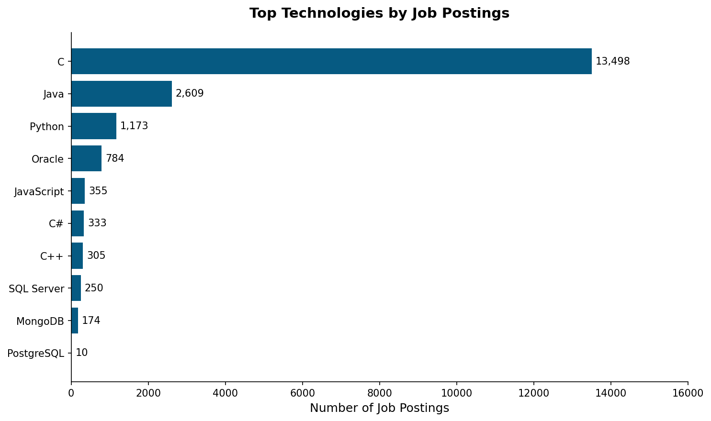
JOB POSTINGS
C leads with 13,498 job postings — nearly 5x more than Java (2,609). Python ranks 3rd with 1,173 postings, reflecting strong cross-industry demand across data science, automation, and enterprise development.

Slide 8
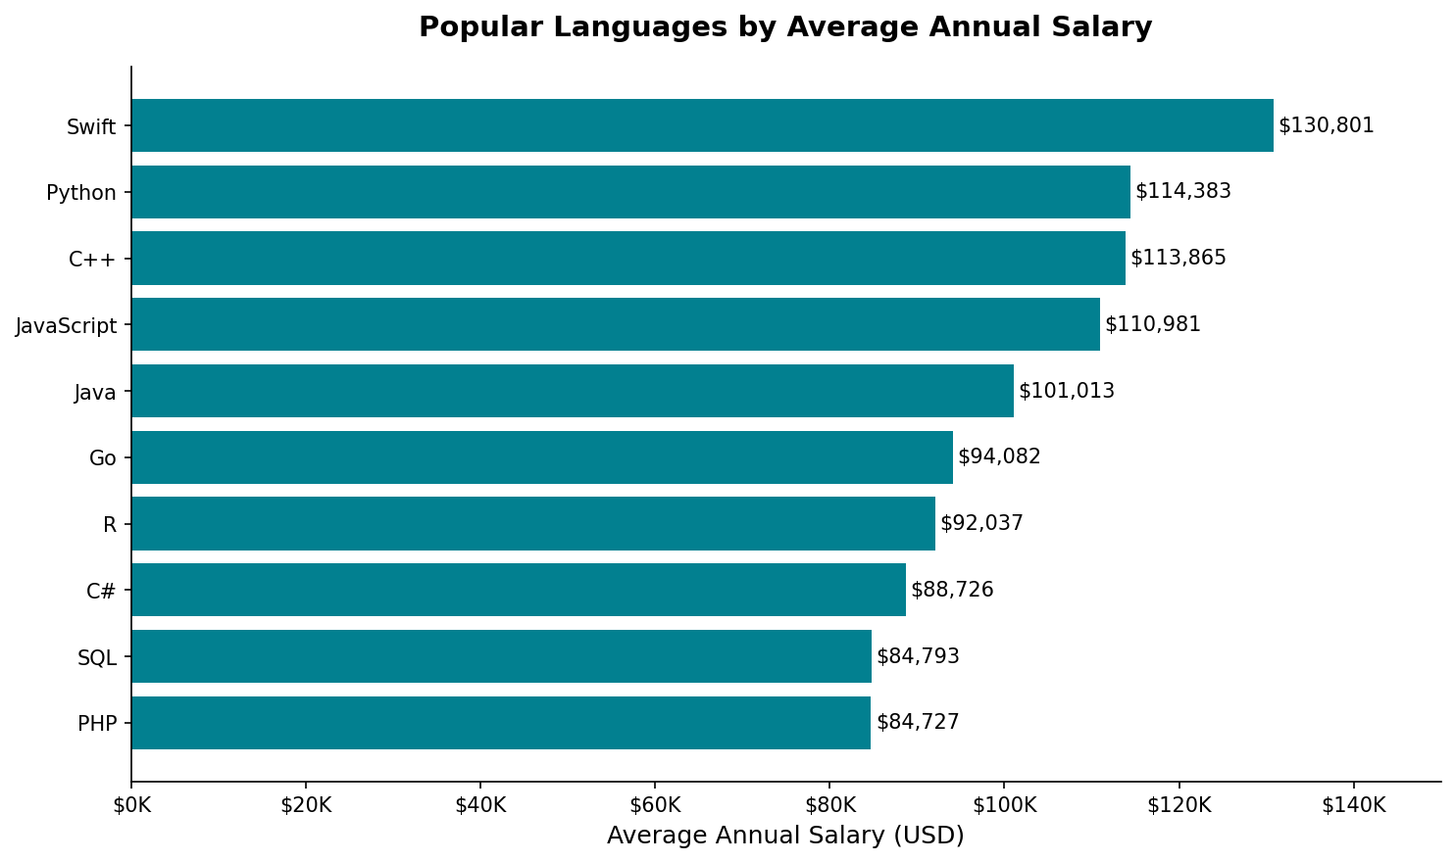
POPULAR LANGUAGES
Swift commands the highest average salary at $130,801, followed by Python ($114,383) and C++ ($113,865). PHP and SQL sit at the bottom of the salary range despite being among the most widely deployed languages — high demand doesn't always translate to high pay.

Slide 9
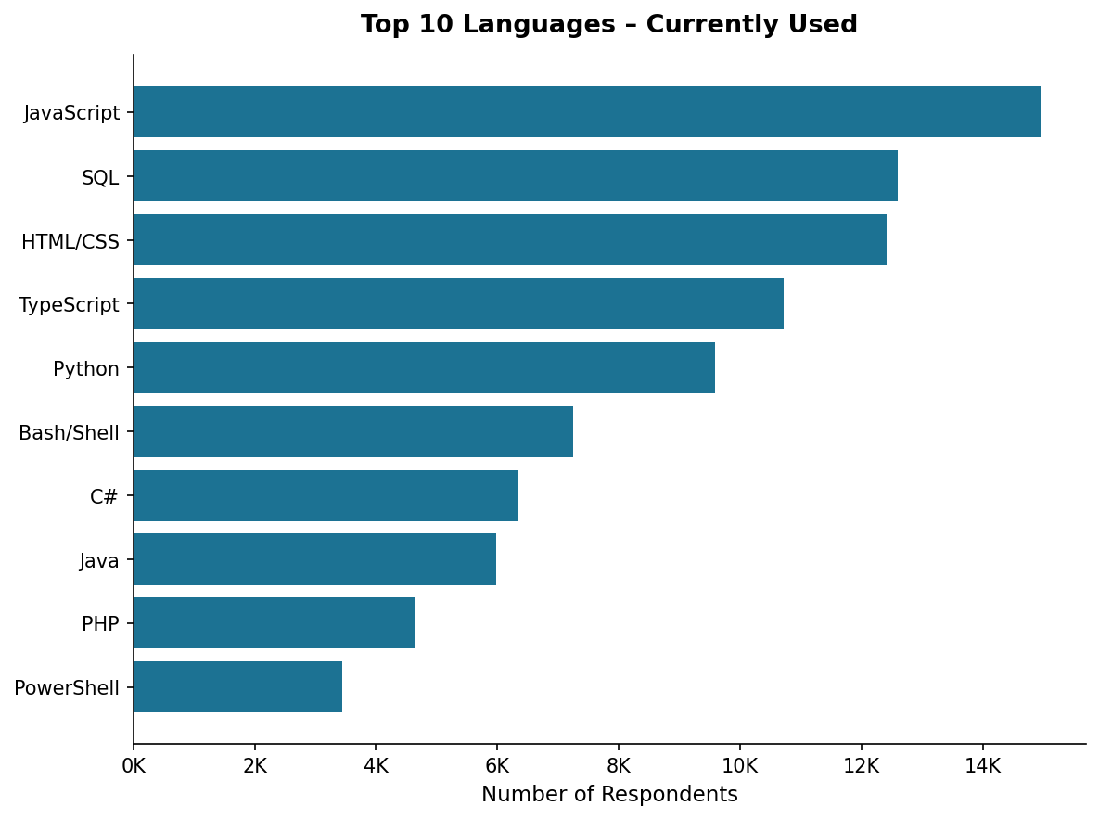
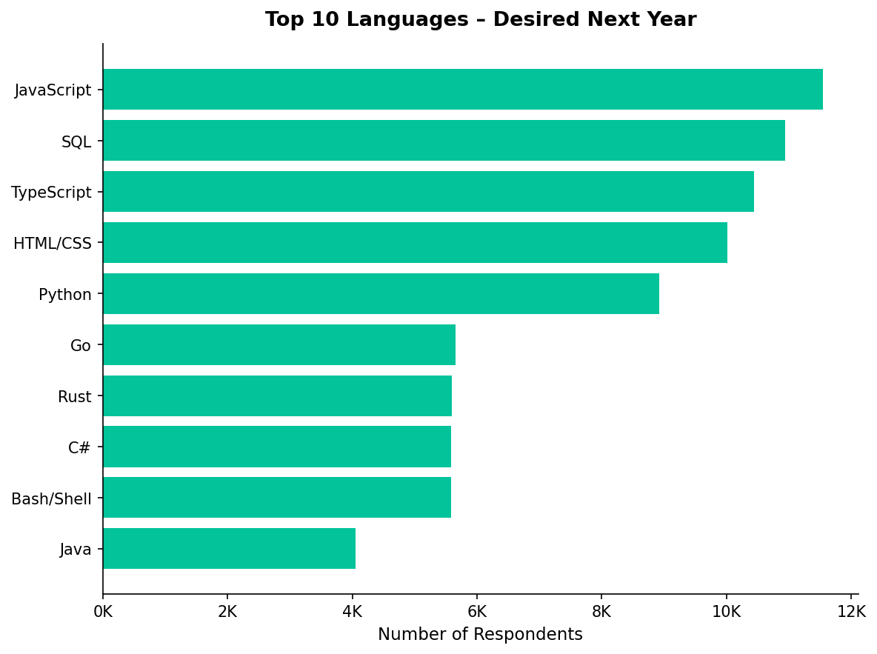
PROGRAMMING LANGUAGE TRENDS
JavaScript, SQL, and Python hold the top positions in both years. Go and Rust enter the desired top 10 — replacing Bash/Shell and PowerShell — signaling growing developer interest in performance-oriented systems languages.

Slide 10
PROGRAMMING LANGUAGE TRENDS - FINDINGS & IMPLICATIONS
Findings
JavaScript remains the #1 language for both current and desired use, cementing its role as the dominant full-stack language.
TypeScript is rising fast — moving from #4 currently to #3 desired — reflecting a shift toward typed, scalable JavaScript development.
Go and Rust enter the desired top 10 but are absent from the current top 10, indicating growing interest in performance-oriented systems languages.
Implications
Organizations should prioritize JavaScript/TypeScript in hiring and training programs — developer demand will only increase.
Investing in Go and Rust skills now provides competitive advantage as these languages move toward mainstream enterprise adoption.
SQL and Python's enduring presence underscores that data fluency remains a core requirement for developers across all disciplines.

Slide 11
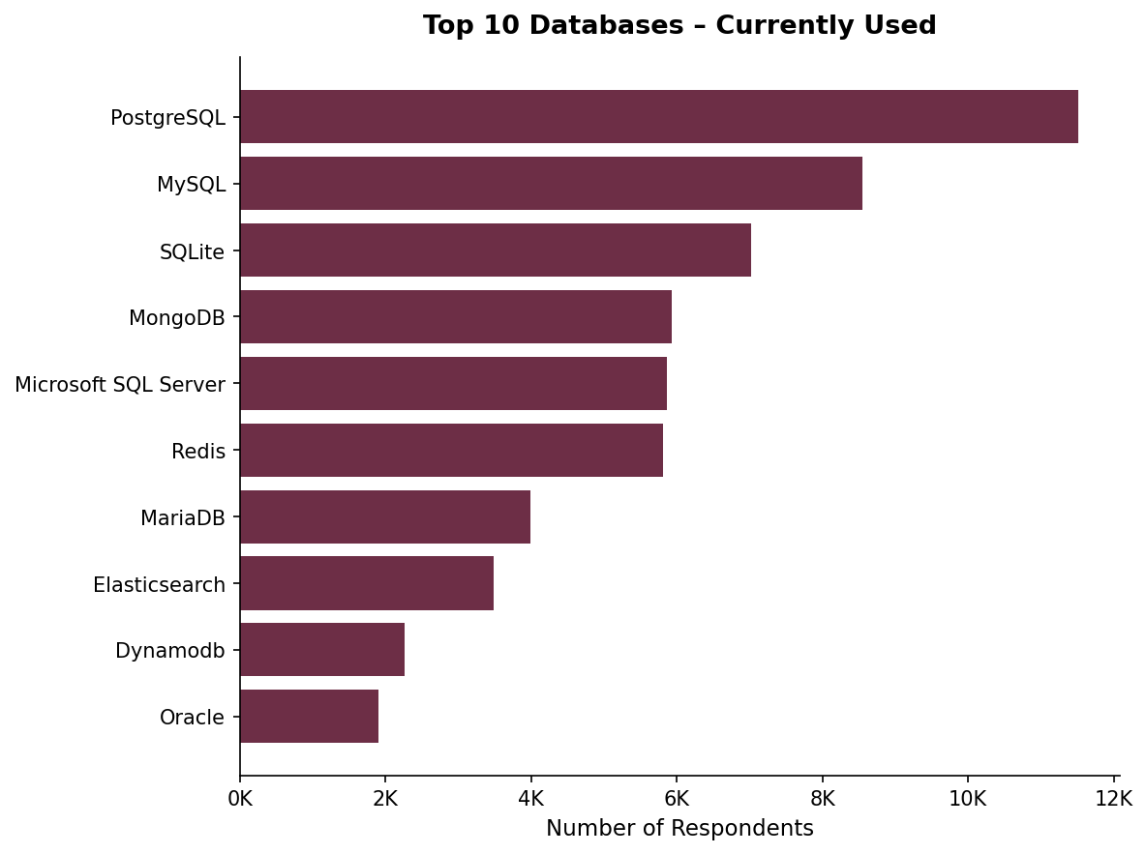
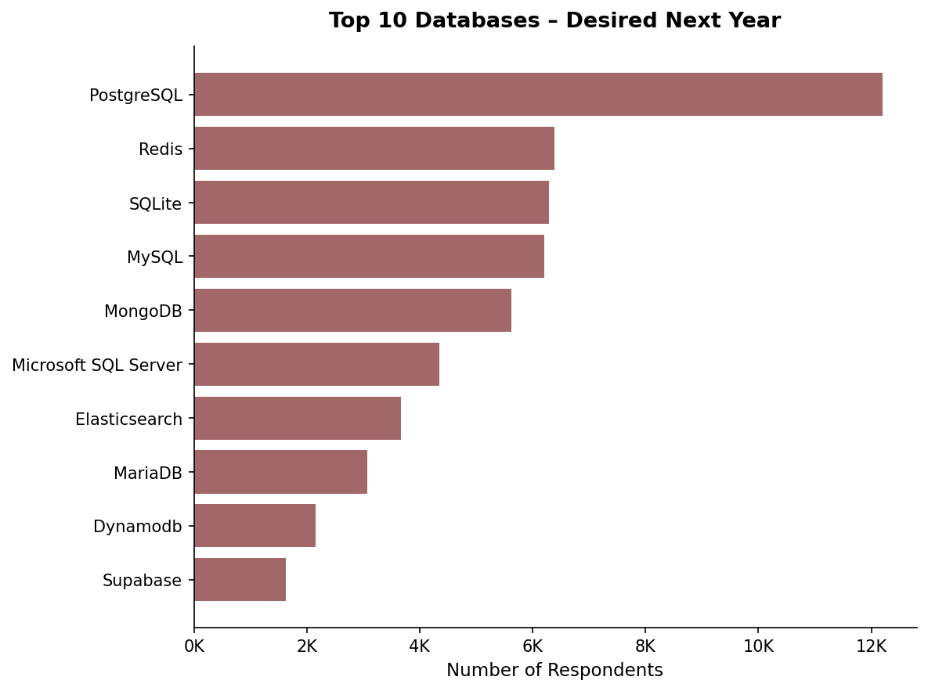
DATABASE TRENDS
PostgreSQL widens its lead from 11,514 to 12,193 in desired use. Redis surges from 6th to 2nd place — reflecting growing interest in caching and real-time data architectures. Supabase appears only in the desired list, signaling demand for modern open-source database alternatives.

Slide 12
DATABASE TRENDS - FINDINGS & IMPLICATIONS
Findings
PostgreSQL is the most used and most desired database, reflecting its strong reputation for reliability, open-source flexibility, and modern features.
Redis surges from 6th (current) to 2nd (desired), signaling a major shift toward caching and real-time data processing architectures.
Supabase appears only in the desired list, pointing to growing developer interest in open-source, modern Firebase alternatives.
Implications
PostgreSQL expertise should be a hiring priority — it leads current usage and is the #1 database developers want to work with going forward.
Redis skills are increasingly valuable, especially for engineering teams building real-time apps, microservices, and high-performance systems.
Emerging tools like Supabase represent early-adoption opportunities, particularly for startups and modern web development teams.

Slide 13

DASHBOARD
The following slides present interactive dashboards built in Google Looker Studio using the Stack Overflow Developer Survey data. Three dashboard tabs cover: Current Technology Usage, Future Technology Trends, and Developer Demographics.

Slide 14
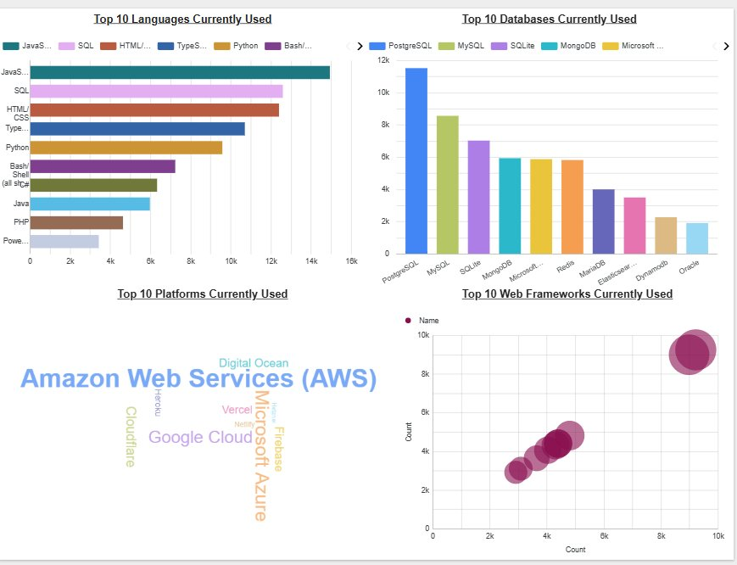
DASHBOARD TAB 1: Current Technology Usage
Dashboard Insight
JavaScript dominates language usage (14,943 users)
PostgreSQL leads databases (11,514)
AWS is the top cloud platform — well ahead of Azure and Google Cloud
Node.js and React lead web framework adoption

Slide 15
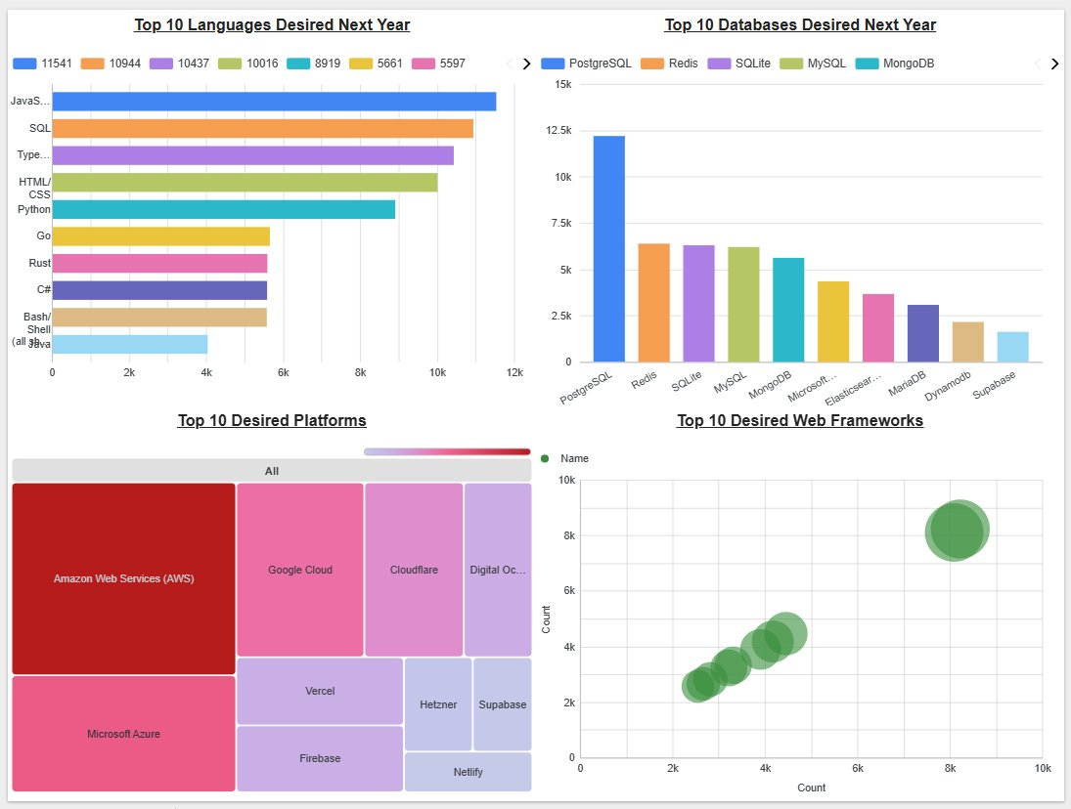
DASHBOARD TAB 2: Future Technology Trends
Future Trends
JavaScript and SQL remain the top desired languages
PostgreSQL widens its lead as the most desired database
AWS dominates desired cloud platforms; Cloudflare and Google Cloud growing
React overtakes Node.js as the most desired web framework
Go and Rust gain significant future interest

Slide 16
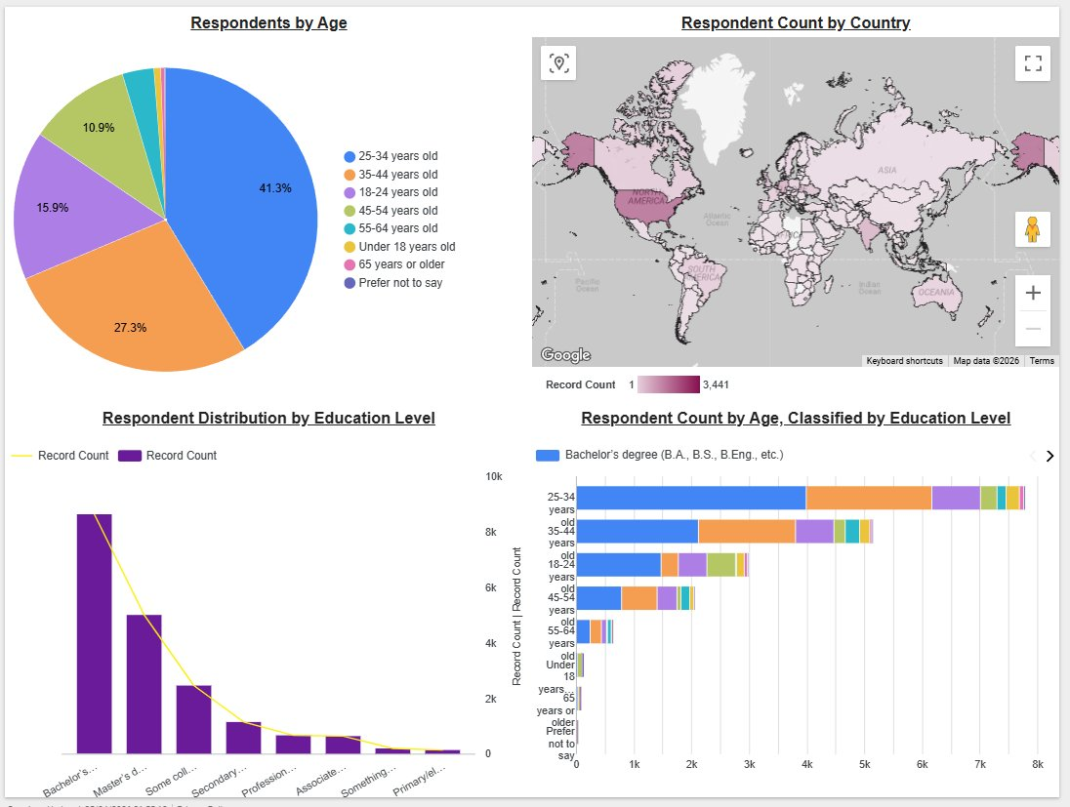
DASHBOARD TAB 3: Demographics
Demographic Insights
41.3% of respondents are aged 25–34; 27.3% are 35–44
Top contributing countries: US, India, and Germany
Bachelor's degree is the most common education level, followed by Master's
Education levels are broadly consistent across age groups

Slide 17
DISCUSSION
Cross-Dashboard Insights:
JavaScript Ecosystem is Unshakeable: Across current use, future demand, and salary data, JavaScript consistently dominates. Its versatility across frontend, backend, and full-stack roles makes it the industry's lingua franca.
Relational Databases Still Rule: PostgreSQL and MySQL remain most-used. Developers clearly still value structured, reliable SQL-based storage despite NoSQL growth.
Cloud-Native is the New Normal: AWS leads platform adoption by a wide margin. Cloud skills are now essential for all developers, not just DevOps specialists.
The Developer Workforce is Young and Educated: With 41.3% aged 25-34 and Bachelor's degrees most common, the industry is driven by a formally educated, relatively young workforce.
Performance Languages on the Rise: Go and Rust entering the desired top 10 signals growing interest in performance, memory safety, and concurrency — all critical for cloud-scale systems.

Slide 18
OVERALL FINDINGS & IMPLICATIONS
Findings
JavaScript is the single most dominant language — no other language matches its adoption breadth in current use or future desire.
PostgreSQL has overtaken traditional enterprise databases and is developers' top choice now and for the future.
C holds the most job postings globally (13,498), while Python and JavaScript are rapidly catching up in employer demand.
The developer community is young (25-34), educated, and concentrated in the US, India, and Germany.
Implications
Companies should build JavaScript/TypeScript-first stacks to attract top talent and align with industry direction.
Migrating from legacy databases (Oracle, SQL Server) to PostgreSQL can reduce costs and improve developer satisfaction.
Salary benchmarking must account for language premiums — Swift, Python, and C++ developers command significantly higher pay.
Workforce programs targeting 18-24 year-olds represent a high-ROI investment as the next developer wave enters the market.

Slide 19

CONCLUSION
Technology trends reveal a clear pattern: JavaScript, SQL, and Python are the foundational languages of modern software development — any organization ignoring these does so at its peril.
The database landscape is evolving rapidly — PostgreSQL leads and Redis is rising fast, reflecting developer priorities around performance, scalability, and open-source solutions.
Job market data confirms C and Java still power enterprise systems, while Python's growth reflects rising demand in data science, AI, and automation.
Organizations aligning their hiring, training, and technology strategies with these data-driven insights will be better positioned to attract top talent, build scalable systems, and make smarter business decisions.

Slide 20

APPENDIX
Additional data and supporting analysis used in this report:
Platform Usage: PlatformHaveWorkedWith_top10.csv and PlatformWantToWorkWith_top10.csv — showing AWS, Google Cloud, and Microsoft Azure as dominant current and desired platforms.
Web Frameworks: WebframeHaveWorkedWith_top10.csv and WebframeWantToWorkWith_top10.csv — Node.js and React lead both current and desired web framework usage.
Demographics: demographics.csv — complete age, education, country, and gender distributions across survey respondents.
Full Dataset: survey_data_updated.csv — the complete cleaned Stack Overflow Developer Survey dataset used as the basis for all analyses in this report.

